Slide 1
GLE Sheet Notes

Slide 2
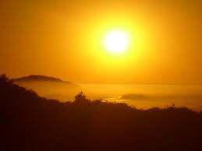
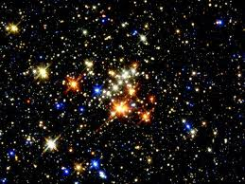
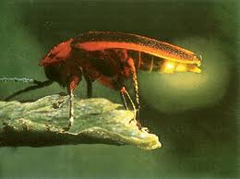
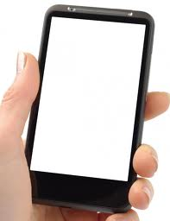
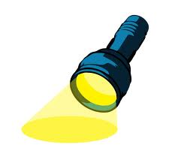
#1
A light source makes its own light

Slide 3
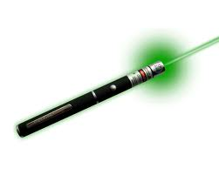
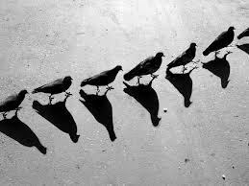
#2
Light travels in a straight line until it reaches a new medium. Evidence:
Laser pointer points where you aim it (it doesn’t change directions, go around corners)
Shadows happen because an opaque object blocks the light (light cannot travel around the object)

Slide 4
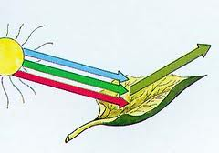
#3
A green leaf looks green, because it absorbs all other colors, but reflects green.
Black absorbs all colors
White reflects all colors

Slide 5
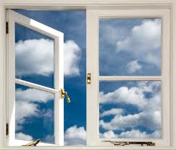
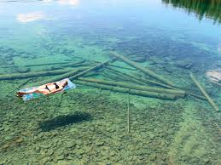
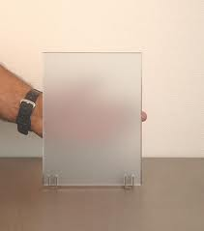
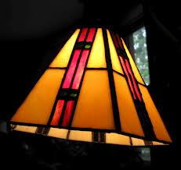
#4
Transparent: see through, light can pass through
Translucent: most light can pass through, but causes a blurry image

Slide 6
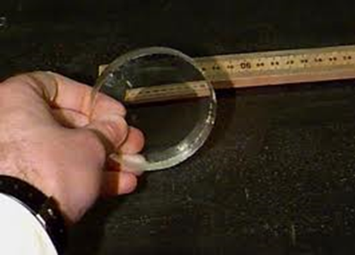
#5
The behavior of light waves (image) will change depending on the type of surface.
Concave Lens: image is smaller, right side up
Convex Lens: image is larger up close, from far away the image inverts

Slide 7
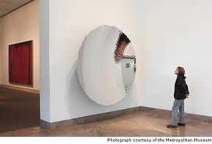
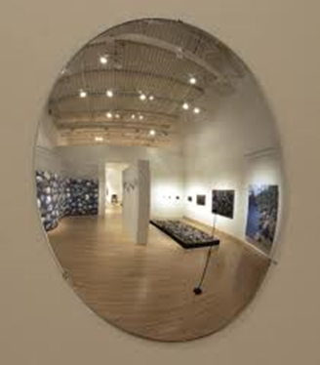
#5 (continued)
Concave Mirror: close up, the image is right side up and magnified, but from far away, the image is smaller, upside down.
Convex Mirror: image is smaller and right side up

Slide 8
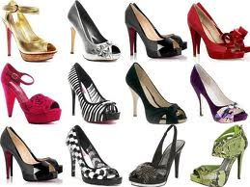
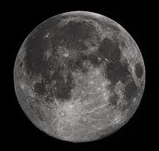
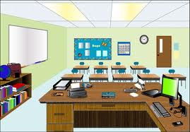
#6
A receiver receives, reflects, or is seen because of light.

Slide 9
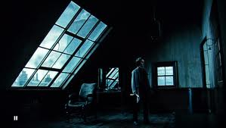
#7
In order to be “seen”, objects must be receivers or sources of light.
You cannot see in the dark.

Slide 10
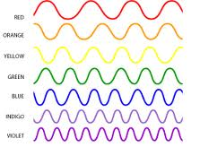
#8
Red= longest wavelength, lower energy
Violet= shortest wavelength, higher energy

Slide 11
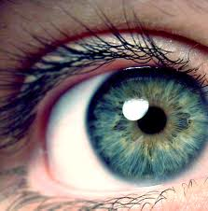
#9
Almost all of the Sun’s energy travels by infrared waves, light waves, or ultraviolet waves.
See pie chart on page 606 in your textbook
Of the visible EM waves, Red has the longest wavelength and the lowest frequency
Violet has the shortest wavelength and the highest frequency

Slide 12
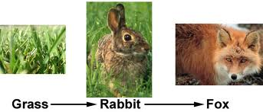
#10
Plants use energy from the sun to make their own food.
Plants are eaten by organisms that cannot make their own food from the sun.
Those organisms are eaten by other organisms.

Slide 13
Video links
http://www.youtube.com/watch?v=MlWhpr6-Rc8 (8 minutes long)
http://www.youtube.com/watch?v=P_PVz8HrrCI (3 minutes long)
http://teachertube.com/viewVideo.php?video_id=26285 (2 minutes long)

