Slide 1
Is it a Chemical or Physical Change?

Slide 2
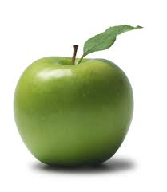
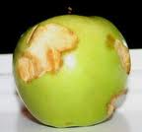
A half eaten apple turns brown.
Physical or Chemical Change?

Slide 3
Chemical Change

Slide 4
Ripping paper into little pieces
Physical or Chemical Change?

Slide 5
Physical Change

Slide 6
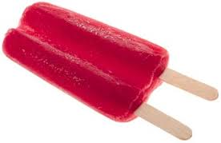
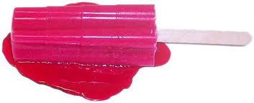
Melting a popsicle
Physical or Chemical Change?

Slide 7
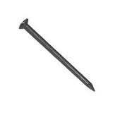
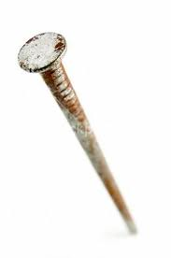
Rust forming on an old nail
Physical or Chemical Change?

Slide 8
Chemical Change

Slide 9
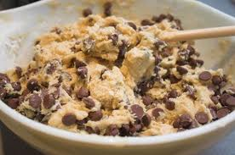
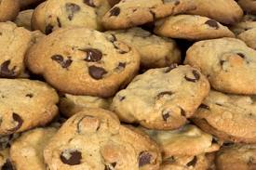
Baking cookies
Physical or Chemical Change?

Slide 10
Chemical Change

Slide 11
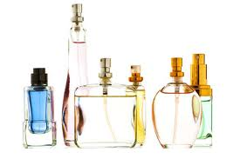
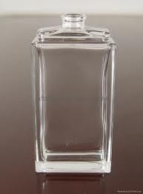
Perfume evaporating from an open bottle
Physical or Chemical Change?

Slide 12
Physical Change

Slide 13
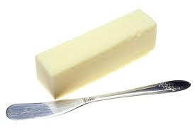
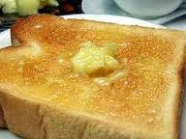
Butter melting on toast

Slide 14
Physical Change

Slide 15
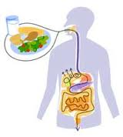
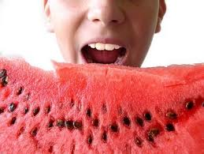
Your body digesting food you ate
Physical or Chemical Change?

Slide 16
Chemical Change

Slide 17
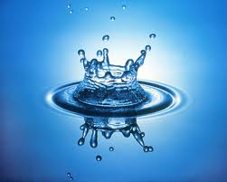
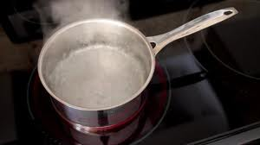
Boiling water on the stove
Physical or Chemical Change?

Slide 18
Physical Change

Slide 19
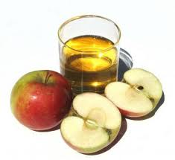
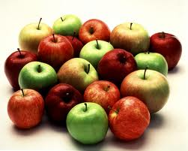
Crushing apples into apple juice
Physical or Chemical Change?

Slide 20
Physical Change

Slide 21
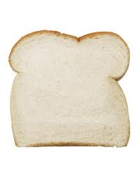
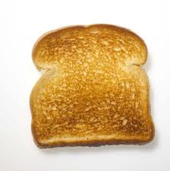
Bread becoming toast
Physical or Chemical Change?

Slide 22
Chemical Change

Slide 23
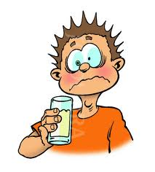
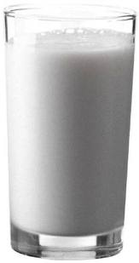
Milk going sour
Physical or Chemical Change?

Slide 24
Chemical Change

Slide 25
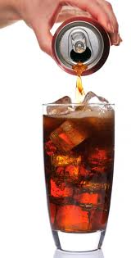
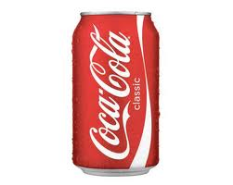
Fizz leaving an open soda
Physical or Chemical Change?

Slide 26
Chemical Change

Slide 27
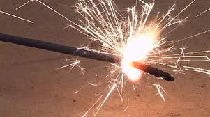
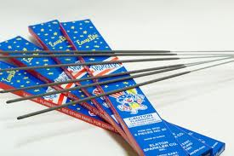
A sparkler lit on the 4th of July
Physical or Chemical Change?

Slide 28
Chemical Change

Slide 29
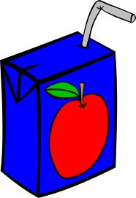
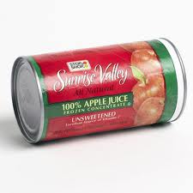
Juice box freezes in the freezer
Physical or Chemical Change?

Slide 30
Physical Change

Slide 31
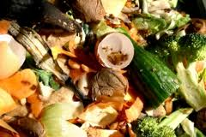
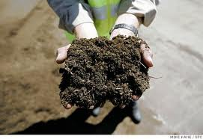
Food Scraps are turned into compost
Physical or Chemical Change?

Slide 32
Chemical Change

Slide 33
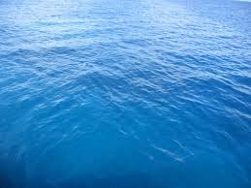
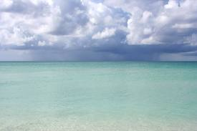
Rain clouds form over ocean waters
Physical or Chemical Change?

Slide 34
Physical Change

Slide 35
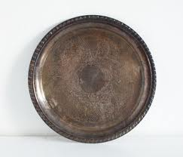
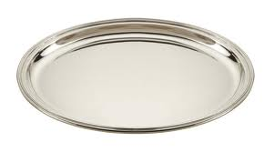
A silver plate turns black from tarnish
Physical or Chemical Change?

Slide 36
Chemical Change

Slide 37
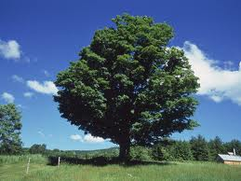
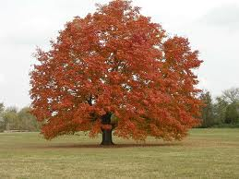
A green leaf turns red in the autumn
Physical or Chemical Change?

Slide 38
Chemical Change

Slide 39
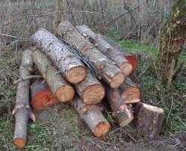
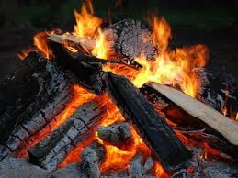
Wood burns in a campfire
Physical or Chemical Change?

Slide 40
Chemical Change

