Slide 1
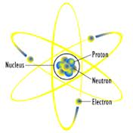
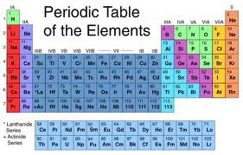
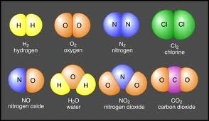
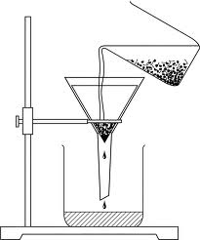
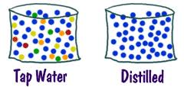
Test Review
Matter and Energy Part 3

Slide 2
Elements
●Pure substance
●Made of only one type of atom
●Found on the periodic table of elements
●Smallest piece is an atom

Slide 3
Examples of Elements
● Gold ● Oxygen
● Hydrogen ● Copper
● Helium ● Silver
● Mercury ● Carbon
● Nitrogen ● Neon
● Chlorine ● Sodium
The Elements Animation

Slide 4
Compounds
●Pure substance
●Made from 2 or more different elements
●Can be broken down into elements or simpler compounds
●Smallest piece is a molecule

Slide 5
Examples of Compounds
●Water
●Sugar
●Sodium Chloride (table salt)
●Carbon Dioxide
●Vinegar
●Ammonia
The Chemistry Rap-Mr. Lee

Slide 6
Elements and Compounds
●Are both pure substances
●Have characteristic properties
●The elements which make a compound have different properties than the compound they create
Meet the Elements

Slide 7
Mixtures
●2 or more substances which are combined physically, but not chemically
●The substances which are combined retain their characteristic properties
●Can easily be separated

Slide 8
Solutions
●A mixture that appears to be a pure substance
●Solute must be evenly spread out throughout the solvent
●Example: salt water
●Since they are mixtures, they can be separated
The Solution Song-Mr. Edmunds

Slide 9
Separating Mixtures
●Use a filter (to get sand out of water)
●Use evaporation (to get the salt from the salt water)
●Use distillation (to get the water from the salt water)
●Use a magnet (to get something magnetic out of something that is not)
●Use hand eye coordination (sorting different colors of legos)
Mixtures Separating-Mr. Parr

Slide 10
Parts of an Atom
●Proton: found in the nucleus
- has a positive (+) charge
●Neutron: found in the nucleus
- has a neutral (0) charge
●Electron: found outside the nucleus
- has a negative (-) charge
●Nucleus: the center of the atom
- consists of protons and neutrons
Inside the Atom-Mr. Parr

